Slide 1
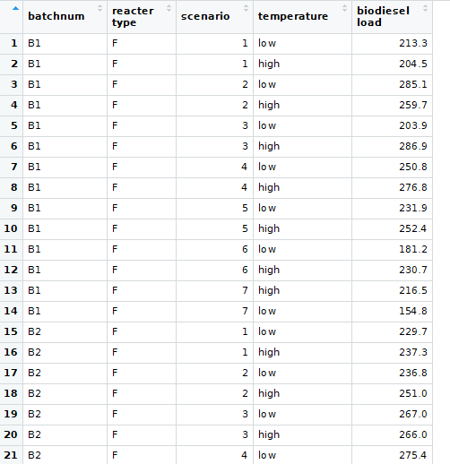
Analyzing the Linear Mixed Effects (LME) Models
How biodiesel production is related to temperature
84 observations – 6 batches
EXPLANATION OF VARIABLES
BATCH NUM – 6 batches of biodiesel RANDOM EFFECT
REACTOR TYPE - Flash / Normal FIXED EFFECT
SCENARIO – 1 TO 6 RANDOM EFFECT
(EX: canola, vegetable,
switch grass, waste oil, beef tallow, mustard, palm oil)
TEMPERATURE– HIGH (70° C) or LOW (40 ° C) FIXED EFFECT
BIODIESEL LOAD – The actual amount of biodiesel (gal)
retrieved from each batch with all different situations RESPONSE

Slide 2
Model equation
Yij = β0+β1Xij +bi1Z1ij+bi2Z2ij+ε

Slide 3
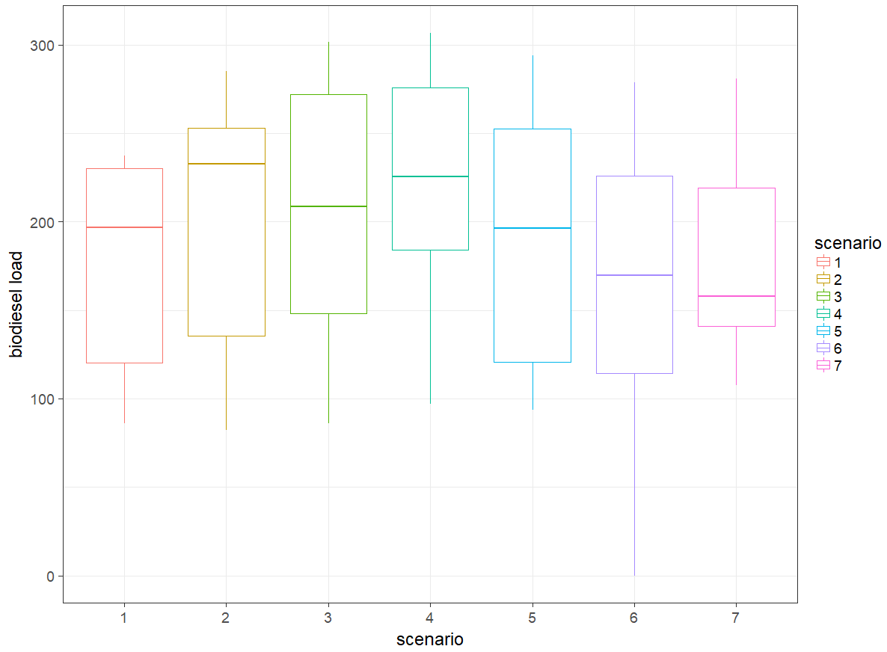
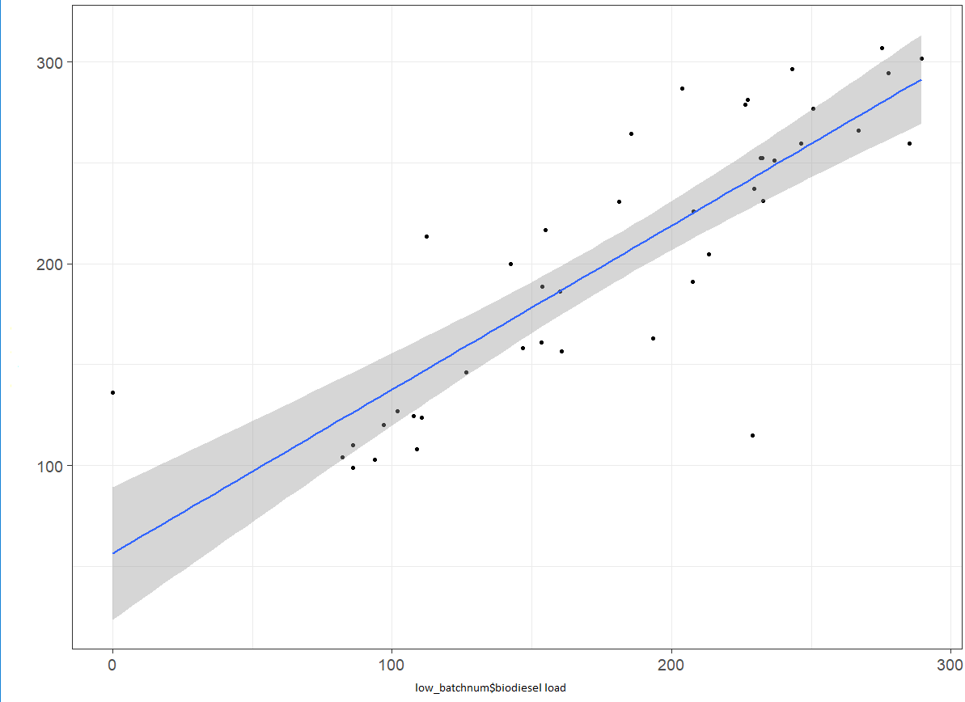
Data Visualization
Temperatures with each batch and biodiesel load
Scenario
1 Canola oil
2 Vegetable oil
3 Switch grass
4 Waste oil
5 Beef tallow
6 Mustard
7 Palm oil

Slide 4
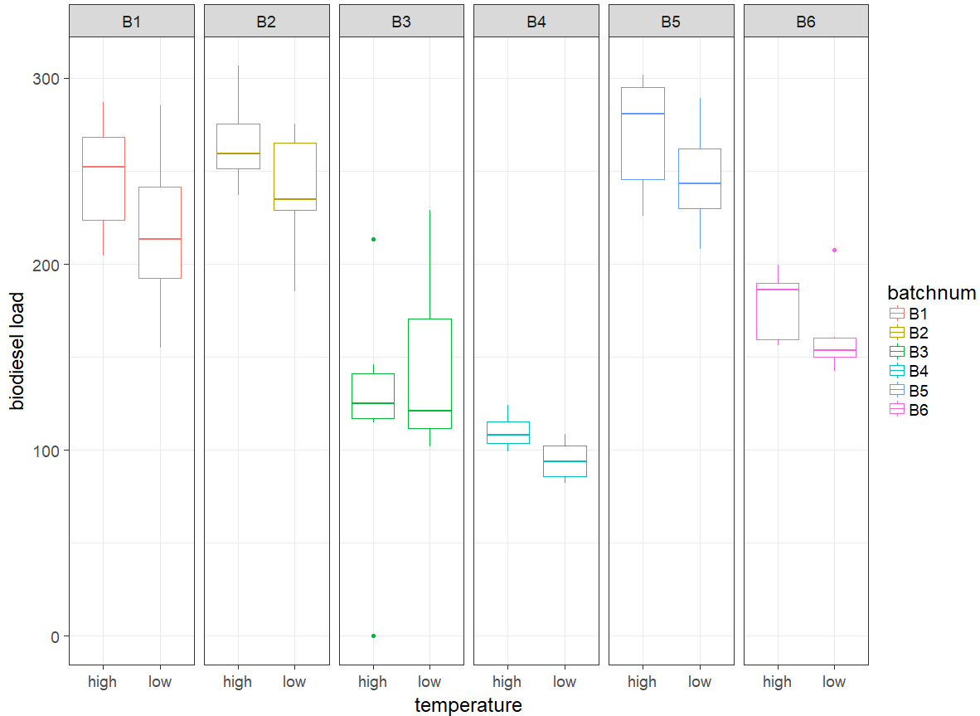
Data Visualization

Slide 5
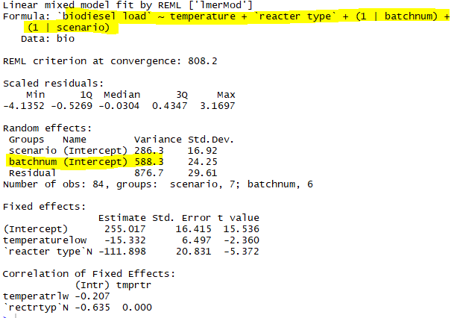
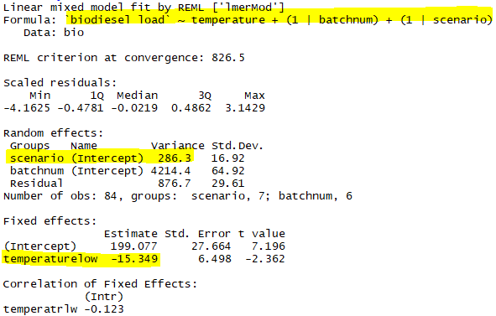
Constructing models
With Only one fixed effect “temperature”
With two fixed effect “temperature” & “reacter type”
Notes:
From wilk’s theorem - > -2*log (likelihood ratio test) -< chisquare distribution with df of number of parameters that differ between models.
Here att

Slide 6
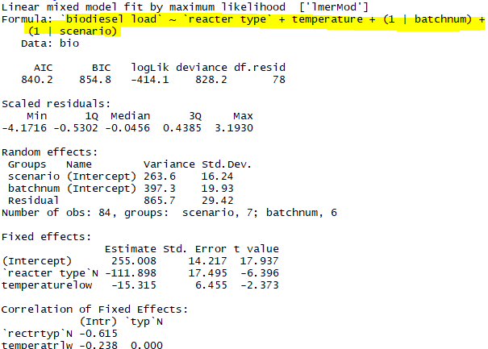
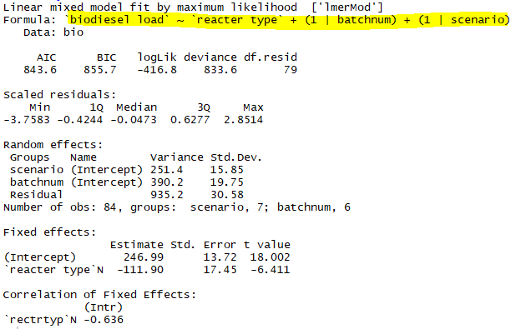
Likelihood ratio test – Anova
Null model
Full model

Slide 7
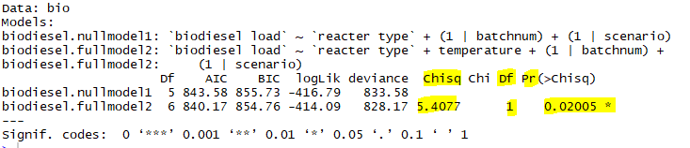
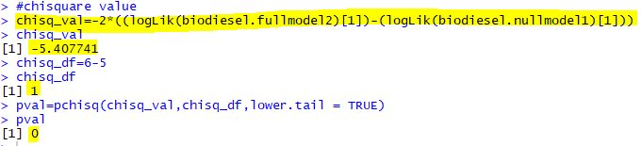
Anova and Chi-square results
Model comparison confirmed that temperature significantly predicts level of biodiesel load with lowering by 15.34 gallons ± 6.49 gallons

Slide 8
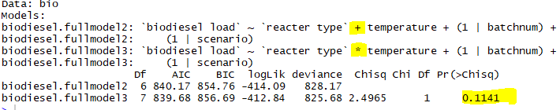
Difference between additive and interactive models

Slide 9
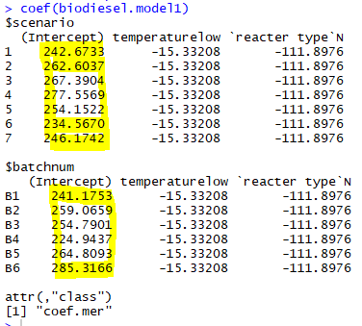
Random intercepts
Random intercept model
Here the baseline differences in biodiesel load
Each batch number and scenario is assigned to different intercept but the effect of temperature is going to be same for all batch number and scenarios
May not be valid assumption
Random slope model is considered with both batch number and scenario having different slopes
Notes:
Each subject and scenario is assigned to different intercept this is what happens when we take by subject and by item variability into account

Slide 10
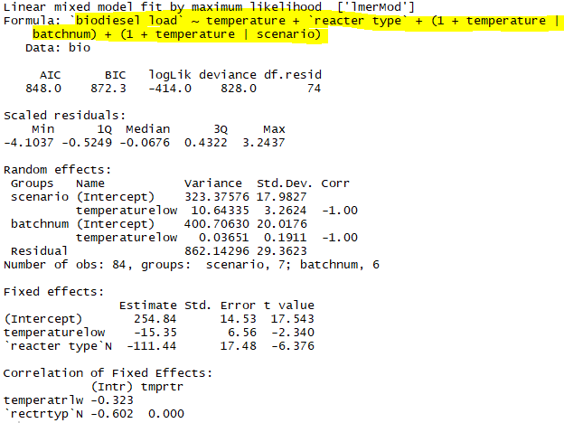
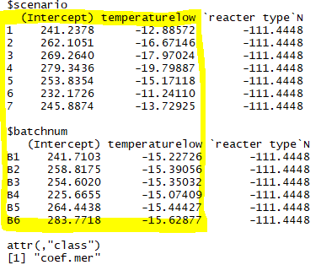
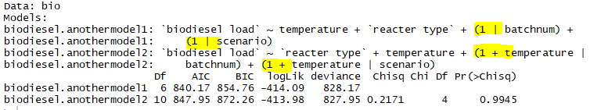
Comparison results for random slopes and random intercepts

Slide 11
Conclusion - Should we use random intercept and random slope?
Researchers in ecology – mixed models without random slopes are giving Type 1 error
Researchers sometimes include random slopes – justified by experimental design mainly for all fixed effects
This Model is solely based on temperature but not on reactor differences
This is the reason we have random slopes for effect of temperature but not for reactor

